Slide 1
BrokerLess
Revolutionizing Renting on the Blockchain

Slide 2
Agenda
1
Overview
2
Platform
3
Process
4
Next Steps
5
Questions

Slide 3
Overview

Slide 4
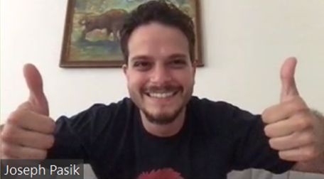
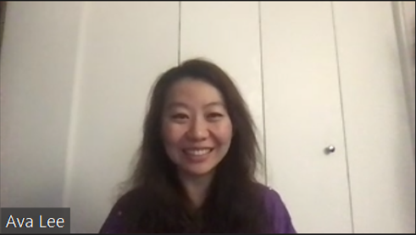
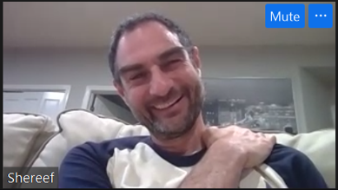
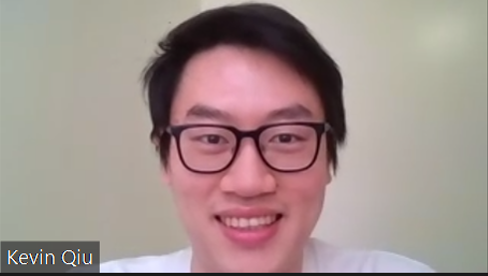

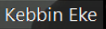
Our Team
Joseph Pasik
Ava Lee
Shereef El-Prince
Kevin Qiu
Kebbin Eke
Lead Developer
Developer
Developer
Developer
Developer

Slide 5
Our Purpose
Create a BrokerLess environment in the leasing space that is trustworthy, fun, virtually free and transparent
“Hakuna Matata"

Slide 6


Our Proposition
Tenants
Previous Tenant
Incentive Fee
Swift Security Deposit return
New Tenant
No Broker Free
Transparency
High yielding interest
BrokerLess
Landlords
Cheaper Fees
Faster Payment
Maximum Rent
Hassle Free
Transparency
Broader Market

Slide 7
Key Challenges
Connecting Contracts
2
Linking the auction contract with the lease agreement and deposit contract
1
3
Frontend Development
Simplifying Contracts
Everything about it
Condensing contracts to eliminate redundancy
4
General Solidity
Integers & Floats
Legal Framework
5
Developing a better understanding of the legal implications

Slide 8
Platform

Slide 9
Our Resources
Solidity
Our main language used for contract development via the remix IDE
Ganache
To manage user wallets and to test account balances for our initial contracts
Visual Studio Code
The second IDE that our team used to connect the backend and frontend
Web3.py
Used to deploy our initial frontend
WiX
Software company providing easy web development services

Slide 10
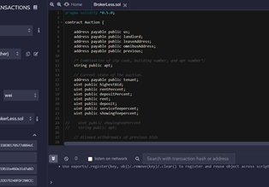

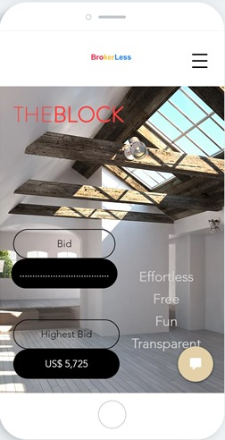
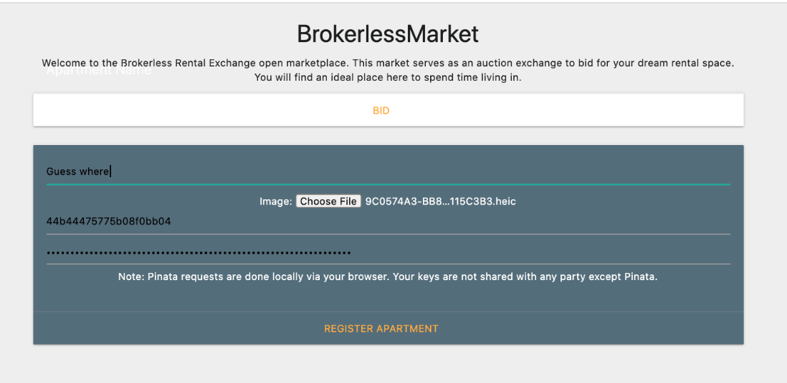
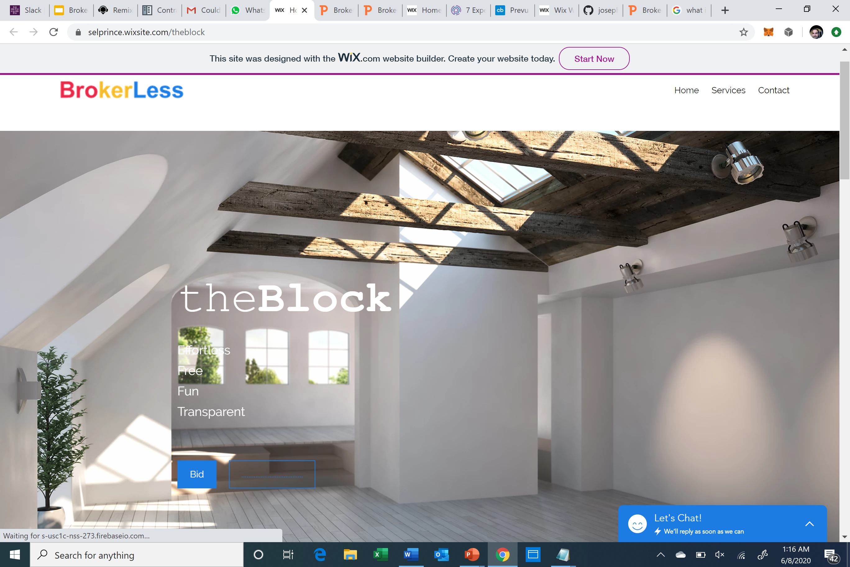
Backend
Our Platform
Frontend
App

Slide 11
Process

Slide 12
Process Overview
Property Listed
Landlords list their property on our platform
1
Auction
2
Prospective tenants bid on properties
Lease Agreement
3
The lease agreement is signed, and a contract is generated
4
Security Deposit
Our platform utilizes smart contracts that safely and securely invest your security deposit

Slide 13







Auction
Rent
Former Tenant
Fees
Deposit
Platform
Feeds into BrokerLess contract (money is split into 3 ways)
Rent payment
Fee payments (2 recipients)
Security deposit payment
The Property Is Listed
The Highest Bidder Wins
View opportunity
Bid on opportunity
Contract created

Slide 14



Lease Agreement
Process
Blockchain
A lease is automatically generated once the landlord accepts the bid, which specifies the duration of the lease, cost of rent, and any other conditions within a standard lease agreement
The contract is stored on the Ethereum blockchain which is a decentralized distributed ledger
Functionality
Security
Tenants: Pay rent through the platform and can receive the security deposit post-contract termination
Landlords: Receive rent payments that are settled almost instantly via the blockchain
All documents and transactions are verifiable and reduce the risk of censorship

Slide 15


Security Deposit
Tenants’ Deposits
Omnibus Account
Bank / Asset Manager
Tenant’s deposits are pulled from their individual lease agreements
The deposits are then pooled into an
omnibus account
The omnibus account is then invested into a
high-yielding savings account
Contract Initiation
Contract Termination
Tenant’s deposit is released back into
their individual wallet
The pooled money is then split and returned to
The lease agreement
The invested funds are credited back to the omnibus account

Slide 16
Next Steps

Slide 17





Next Steps
Critical Features
Background Checks & Reviews
1
There are several features that we would like to add to our platform
Background checks for landlords and reviews for all users
Expanded Deposit Investment Options
2
ETFs, mutual funds, crypto staking, etc.
More Flexible Payment Features
3
Allow the security deposit to be applied to property damages, rent, late fees, etc.
Timed Contracts
4
Greater timing flexibility for lease duration

Slide 18
Additional Developments
Machine Learning
Employ machine learning models to evaluate a tenant’s credit worthiness and assign a profile evaluation
Document Support
Incorporate paper contracts as URIs. Also includes repair bills, utility bills, insurance payments, taxes, etc.
Interoperability
Link the platform with other property listing websites and applications
Security Deposit Loans
Allow tenants to offer a higher security deposit amount to the landlord
Property Photos
Commission local university photography students to take photos of the property (professional quality photos at a discounted price)
Property History
Add “events” to the network to keep track of damage reports and overall property history
Our team will continue to expand this project over time

Slide 19
Our Testimonials
“They are revolutionizing how landlords and tenants connect when buying and selling property rentals”
- Landlord / Industry Expert (@Adam Behrman)
“As a landlord this platform provides a great opportunity for me to partner with my tenants in a seamless and cost-efficient way”
- Landlord / Student Advisor (@David Sison)
“I LOVE TEAM 4!”
- Top User / Premium Account Holder (Peter Repetto)

Slide 20
Questions

Slide 21
Appendix

Slide 22

Process Overview (v2)
Property Listing
Lease Agreement
Contract Termination
Landlords list their property on our platform
Landlord and Tenant sign the lease agreement
At termination of the existing contract the process restarts
Auction
Security Deposit
Prospective tenants bid on properties
The deposit gets invested

Slide 23




Technical Flowchart
Property Listing The Landlord adds their property to our frontend platform theBlock
Lease Contract The Landlord selects the winning bidder
Lease must be confirmed by the:
Landlord
New Tenant
Constructors:
Landlord - address
New Tenant - address
Omnibus - address
Rent - uint
Deposit - uint
Apt - string
Omnibus Contract Deposits earn interest from the bank which is then returned upon termination of the underlying lease contract
Fees The winning bid amount gets split between:
Former Tenant(s) - 25% of 1st month rent
Our Platform - 5% of 1st month rent
Deposit The deposit is equal to the first month’s rent
Auction Contract The platform launches the auction
for the Landlord
Omnibus Account Goes into an omnibus account and there’s a record of each person's ownership of that account
Return Deposit Landlord must confirm the contract before the deposit is returned
Notes:
Flowchart idea courtesy of Adam

Slide 24


Fees
Former Tenant(s)
Landlord
Our Platform
Earn 25% of the first month’s rent
Saves 3% on broker fees
Utilizes 5% of the first month’s rent to build the ecosystem

Slide 25



Lease Terminations
Our Platform allows for a more stable lease termination process.
By incentivizing departing tenants to act as brokers we reduce the operational hassle for landlords who are looking for new tenants, and at a much lower cost.

